Slide 1
Harnessing Intellectual Property Rights (IPR) among students
Prof. Krishna Misra, Ph.D.,FNASc., FBRSI
Hon.professor, Indian Institute of Information Technology
Allahabad

Slide 2
What is Property
Property is synonymous with private wealth.
Property is bundle of rights (ownership)
Property may be Corporeal or incorporeal.
Corporeal property may be movable or immovable
Incorporeal property may be lease securities or intellectual

Slide 3
CORPOREAL AND INCORPOREAL PROPERTY
In addition to the classification of property into movable and immovable, personal and real, there is another division also to be noted, that of corporeal and incorporeal.
By corporeal property is meant visible and tangible property, as a house, a parcel of land, vehicle and the like ; while an annuity, or annual rents derived from land, is incor poreal property, since it has only a mental existence, is intangible, invisible, and only exists in contemplation of law.

Slide 4
Intellectual Property Rights (IPR)
An Intellectual Property is any product of human intellect that is unique, novel , non-obvious and has some commercial value
Intellectual Property Rights are the rights given to persons over the creations of their minds.
IPR are a class of legal rights for which law provides protection
The creator gets an exclusive right over the use of his/her creation for a certain period of time.
These rights give no liability to ignore the rights of other individuals or to override public liabilities.

Slide 5
Basic Forms of IPR
The international community is taking steps to achieve uniformity regarding the nature of these IPR rights , their enforcements and sanctions of their breach. The four basic forms of IPR are,
Patents
Industrial designs
Trade Marks
Copyrights
The first three are collectively known as Industrial property

Slide 6
Definition of patent
A patent for an invention is granted by a government to the inventor giving the inventor the right for a limited period to prevent others for making, using or selling the invention without due permission from the inventor. A patent can be,
(a) bought
(b) sold
(c) rented , or
(d) hired

Slide 7
Features of Patents
A patent in itself is not a right to sell a product. It is only to prevent others from doing so.
Other regulatory approval may be required to commercialize the invention even after getting the patent.
A patent owner can infringe other patents based on the same underlying invention (eg. A process patent owner can infringe a product patent)
Patents are granted in each country by the patent office for a fixed period.
Invention patented in one country will have monopoly rights only in that country
There is no “World Patent”. Patents are granted by individual nations

Slide 8
Patent Types
1. Product patents:
New Chemical entity
Different polymorphic/isomeric forms of a molecule
Different crystalline forms of a molecule
Amorphous form of a molecule
Different hydrated forms of a chemical entity
Gene
Peptide/polypeptides
2. Composition patents: These patents claim different types of pharmaceutical composition of a product.
3. Process patents:
Different methods of manufacturing a product,
A+B=X, or
C+ D=X
(b) Product by process: Process of making polypeptide by using recombinant DNA technology.
No one, but the patent owner is allowed to use or commercialize the product even if produced by a different process.
4. Method of use patent: Different indications for a product may be claimed e.g. Paracetamol is used in fever, headache and some cardiovascular conditions

Slide 9
Addresses of the patent offices in India
1. The Patent Office,
Intellectual Property Office Building,
CP-2 Sector V, Salt Lake City,Kolkata-700091,
Phone : 23671945, 1946, 1987, FAX-033-2367-1988, Email:- kolkata-patent@nic.in
2. The Patent Office,
I ntellectual Property Office Building,
G.S.T. Road, Guindy, Chennai-600032,
Phone: 044-22502081-84 FAX: 044-22502066, Email: chennai-patent@nic.in
3. TThe Patent Office,
Intellectual Property Office Building,
Plot No. 32, Sector 14, Dwarka,
New Delhi-110075,
Phone : 011-28034304, 28034305, 28034306
FAX:011-28034301, 28034302
Email: delhi-patent@nic.in
4. The Patent Office
Boudhik Sampada Bhawan,
Near Antop Hill Post Office, S.M.Road,
Antop Hill, MumbaiI - 400 037.
Phone : 24137701, 24141026, 24150381, 24148165, 24171457 FAX : 24130387
EMAIL: mumbai-patent@nic.in

Slide 10
Jurisdiction of Patent offices
Mumbai office: States of Gujrat, Maharashyra, Madhya Pradesh, Goa and Chattisgarh & the Union territories of Daman and Diu , Dadra and Nagar Haveli.
Delhi Office: The states of Haryana,Himanchal Pradesh,Jammu & Kashmir, Punjab,Rajasthan, Uttar Pradesh,,Uttaranchal, Delhi and the Union territory of Chandigarh.
Chennai office: The states of Andhra Pradesh, Karnataka, Kerala, Tamil Nadu , Pondicheri and the Union territory of Lakshadeep.
Kolkata office: The rest of India

Slide 11
Prior art and searching for patents
Prior art is the knowledge that relates to your invention. It includes previous patents, trade journal articles, publications (including data books and catalogs), public discussions, trade shows, or public use or sales anywhere in the world.
Patents are organized by class and subclass of invention, (similar to the way books are organized in a library). By using the classification system you can find and examine patents that are in the same field (class) as your idea.
You can conduct your patent search of databases online.
You can also visit a specialised library that stores copies of issued patents.

Slide 12
Plagiarism is Academic dishonesty
The world of academics has always been getting social admiration and respect; the scholars functioning in the area are amongst the most revered in the society.
This community which happens to be the creator of knowledge and wisdom has also been blamed of types of shortcomings and “plagiarism” has been termed as the most alarming of these. The issue finds genesis in what can be said as „Academic dishonesty‟.
Plagiarism is not a crime per se but in academia and industry, it is a serious ethical offense, and cases of plagiarism can constitute copyright infringement

Slide 13
Important websites
US patent office: www.uspto.gov
UK patent office: www.patent.gov.uk
Japan patent office: www.jpo.go.jp
WIPO: wipo.org/wipo.int.
European patent office: www.epo.org
World trade organization : wto.org
Manual of patent examining procedure: uspto.gov/web/index, html

Slide 14
Definition of Plagiarism
According to oxford dictionary plagiarism is:
“The practice of taking someone else’s work or ideas and passing them off as one’s own”
http://www.oxforddictionaries.com/definition/english/plagiarism
The Legal dictionary mentions it as :
“The act of appropriating the literary composition of another author, or excerpts, ideas, or passages there from, and passing the material off as one's own creation.”
http://legaldictionary.thefreedictionary.com/plagiarism

Slide 15
Ten main forms of Plagiarism
Submitting someone’s work as your own.
Taking passages from your own previous work without adding citations.
Re-writing someone’s work without properly citing sources.
Using quotations, but not citing the source.
Interweaving various sources together in the work without citing.
Citing some, but not all passages that should be cited.
Medling together cited and uncited sections of the piece.
Providing proper citations, but fail to change the structure and wording of the borrowed ideas enough.
Inaccurately citing the source.
Relying too heavily on other people’s work. Failing to bring original thought into the text.

Slide 16
Intentional (Deliberate) & Unintentional Plagiarism
Intentional or deliberate plagiarism can be termed as dishonest and unintentional as negligent plagiarism
Negligent plagiarism means ignorantly or carelessly presenting another
person’s work as one’s own without acknowledging the source. It arises from one’s inadequate knowledge and competency in writing. It is also due to careless attitude resulting into non-compliance of standard verification procedures. In this type of plagiarism the degree of copying is not substantial. .
Dishonest Plagiarism means knowingly and deliberately presenting another person’s work as one’s own work without acknowledging the source. It is paraphrasing too close to the original (patchwriting).
It involves intentional copying of substantial proportions of the other’s work without written or unwritten permission and also without acknowledging the source.

Slide 17
How to avoid unintentional Plagiarism?
Research Do’s
Take notes in your own words.
Indicate clearly in your notes where different ideas come from (try color-coding things you copy or paraphrase from different sources
or use some form of margin notations, such as “M” for “my
thoughts” and “S1” for “source #1,” etc.).
Indicate clearly which ideas are your ideas and which ideas come from another source
Copy direct quotations word for word. Use quotation marks.
Note page number!
Keep track of all bibliographic information and the date you retrieved the information if from the Web.
Save draft versions of your writing as you proceed so that if you accidentally delete a citation while revising, you can go back and get it.

Slide 18
Research Don’ts
Cut and paste material directly into your paper.
Patchwrite : Copying a passage and changing only an occasional word here and there.
Forget to cite!

Slide 19
Essential requirement for students
All students should necessarily be required to submit a signed statement that they are aware of the plagiarism policy of the University/Institute and no part of their work be it assignment, term paper, project report, thesis or dissertation etc is not copied in any form and it is their own creation .

Slide 20
Procedure for handling alleged Plagiarism
Procedural Fairness :
The UniversitIes/institutions are committed to dealing with alleged plagiarism by any section of their community in accordance with the principles of procedural fairness, including the right to:
(a) Be informed of the allegations against them in sufficient detail to enable them to understand the precise nature of the allegations and to properly consider and respond;
(b) Have a reasonable period of time within which to respond to the allegations against them;
(c) Have the matter resolved in a timely manner;
(d) Impartiality in any investigation process; and
(e) An absence of bias in any decision making

Slide 21
:
Punishment for plagiarism
Plagiarism in research is the counterpart of “Copying”in examinations and should be dealt with similar manner,Depending upon the severity of crime the punishment could be:
1.Fine or warning
2. Rustication for limited period or permanent
3. Withdrawal of degree

Slide 22
Types of Plagiarism
        Wholesale:
        Patchwork
        Idea-based
        Sprinkle

Slide 23
Types of Plagiarism
Wholesale: Copying an entire source or a large section of a source and passing it off as one’s own work.
Patchwork: Copying portions of multiple sources, connecting them together, and submitting the resulting document as one’s own work.
3. Idea-based: Presenting someone else’s unique interpretation, theory, or analysis as one’s own.This constitutes plagiarism even if the wording has been changed.
4. Sprinkle:Occasional failure to cite properly through missing information, errors in punctuation, etc. This is often unintentional.

Slide 24
What is “Paraphrasing”?
In a paraphrase, the goal is to rewrite a statement into different words and with a different sentence structure without losing the original meaning of the text and while maintaining the same general length as the original.
Using phrases directly from the source without putting them in quotation marks constitutes plagiarism.
Following the same sentence structure while changing only a few words also constitutes plagiarism.

Slide 25
Top 10 FREE Plagiarism Detection Tools
Anti-Plagiarism
DupliChecker
PaperRater
Plagiarisma.net
PlagiarismChecker.com
Plagium:
PlagTracker
Viper
SeeSources
Plagiarism Detector

Slide 26
Copyright
According to US constitution copyright is “To promote the progress of science and useful arts, by securing for limited times to authors and inventors the exclusive right to their respective writings and discoveries.”
The purpose of Copyright is to give the creator control and a monopoly on royalties for a period of time and it promotes creativity.

Slide 27
What is protected?
literary works (e.g., all text, including computer software);
musical works;
dramatic works;
pantomimes and choreographic works;
pictorial, graphic, and sculptural works;
motion pictures and other audiovisual works;
sound recordings;
architectural works.

Slide 28
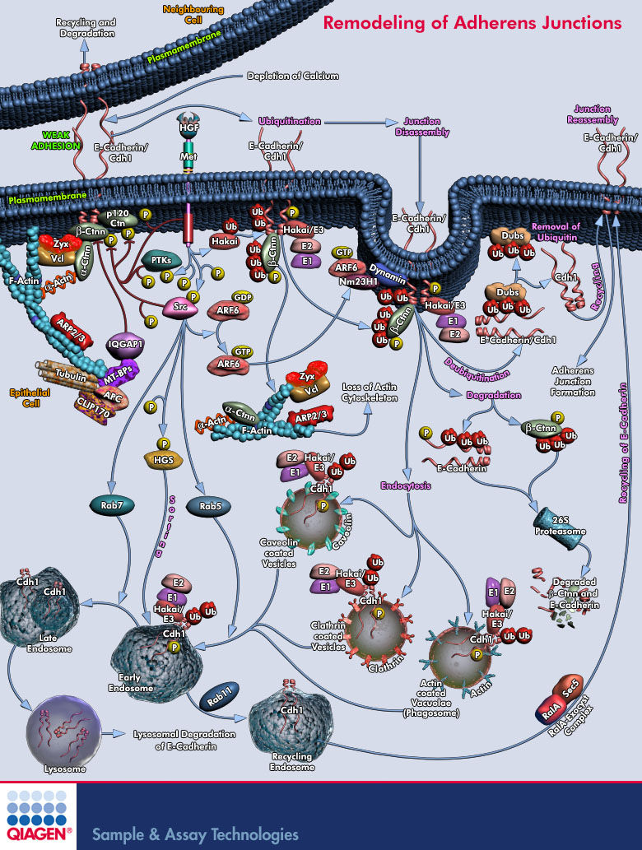
Photographs are “Pictorial Works”
Notes:
Add examples of images to enhance the program. This is just a “clip art” filler from PowerPoint

Slide 29
Facts about Copyright
Photographs, text and video are all copyrighted the moment they are created.
No action is required by the creator of photographs, text or video in order to protect their works. All creative works are protected instantly.

Slide 30
What is not protected?
ideas, concepts, or discoveries;
titles, names, short phrases, and slogans;
works that are not fixed in a tangible form of expression such as improvised speech or dance;
works consisting entirely of information that is commonly available and contains no originality;
anything written or created by the US government.
Notes:
Remind the audience that other laws may protect these categories, for example, short phrases could have trademark protection.

Slide 31

BE CREATIVE, AVOID PLAGIARISM...and respect copyright

Slide 32
THANK YOU

